Slide 1
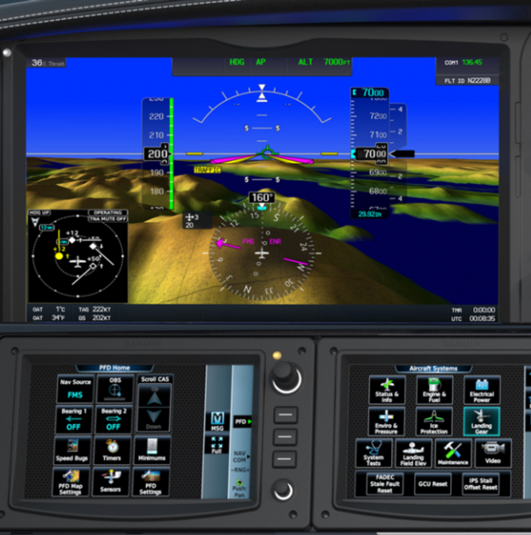
CIRRUS SR20/SR22
Circuit Electrique

Slide 2
CIRRUS SR20/SR22

Slide 3
CIRRUS SR20/SR22 ELECTRICAL SYSTEM
GENERALITES
28 Volt DC
Negative Ground
Dual Alternator
Dual Battery
The system provides uninterrupted power for:
the avionics,
flight instrumentation,
lighting,
and other electrically operated and controlled systems during normal operation.

Slide 4
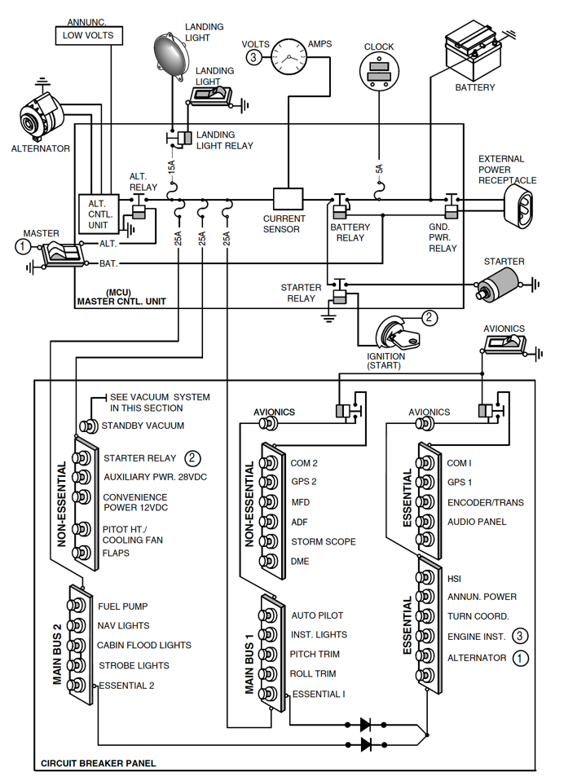
CIRRUS SR20/SR22 ELECTRICAL SYSTEM
SCHEMATIC

Slide 5
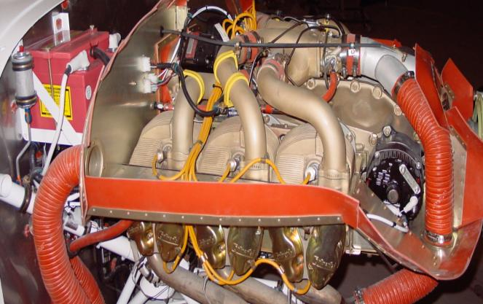
CIRRUS SR20/SR22 ELECTRICAL SYSTEM
COMPONENTS
Alternator 1
100/60 Amp (60 amp no A/C)
28 Volts
Gear driven
Internally rectified
Self exciting (requires battery voltage for field excitation in order to start operating)
Powers Main Distribution bus directly and Essential Bus indirectly

Slide 6
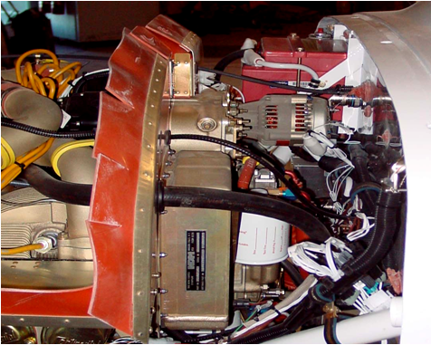
CIRRUS SR20/SR22 ELECTRICAL SYSTEM
COMPONENTS
Alternator 2
20 Amp
28.75 Volts
Gear Driven
RPM dependant < 1700 rpm it will not work
Internally rectified
Self exciting (requires battery voltage for field excitation in order start operating)
Powers Essential Bus
Cannot power Main Distribution Bus (diodes)

Slide 7
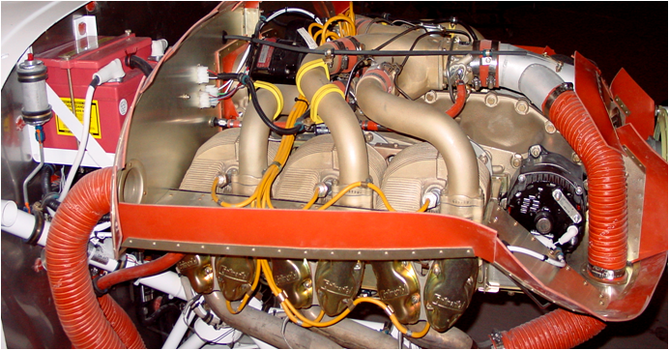
CIRRUS SR20/SR22 ELECTRICAL SYSTEM
COMPONENTS
Battery 1
Aviation grade 12-cell
24-Volt
10 amp-hour
Mounted on right side of firewall
Charged by Alt 1 through Main Dist Bus
Can supply power to the Main and Essential Distribution Buses

Slide 8
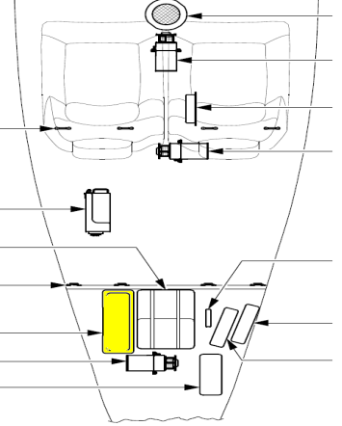
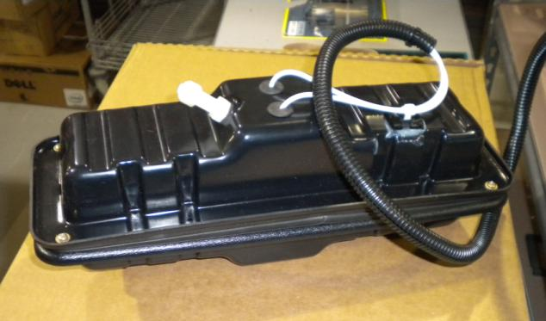
CIRRUS SR20/SR22 ELECTRICAL SYSTEM
COMPONENTS
Battery 2
Two 12 volt batteries in series = 24 volts total
7 amp-hour
Sealed lead acid
Located in the tail of the airplane below the parachute canister
Charged by Alt 1 or Alt 2 from a circuit breaker on the Essential
Distribution Bus
Powers Essential DistributionBus only due to isolation diodes

Slide 9
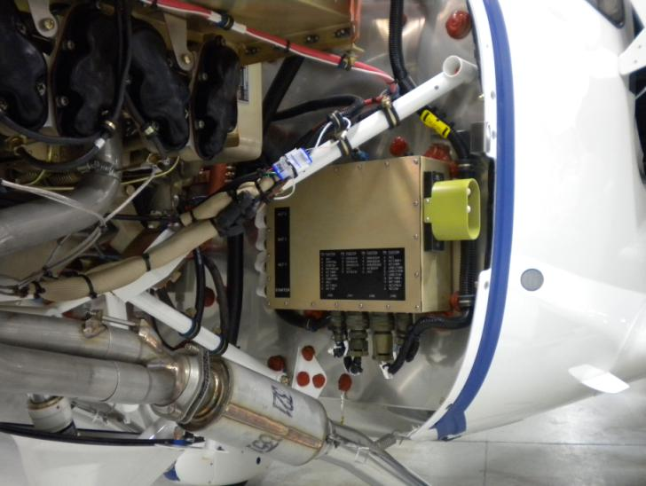
CIRRUS SR20/SR22 ELECTRICAL SYSTEM
COMPONENTS
Master Control Unit (MCU)
Controls: ALT 1, ALT 2, starter, landing light, external power and generation functions
Provides:
ALT 1 and ALT 2 voltage regulation and overvoltage protection
External power reverse polarity protection
Electrical health annunciations to the Integrated Avionics System

Slide 10
CIRRUS SR20/SR22 ELECTRICAL SYSTEM
COMPONENTS
ISOLATION DIODES
Electrical “check valves” or “one way street”
Electricity can only flow in the direction of the arrows
Prevent ALT 2 from powering the Main Distribution Bus
Prevent BAT 2 from powering the Main Distribution Bus
Check operation of diodes during preflight by turning only BAT 2 on
and then verifying flap position light is out

Slide 11
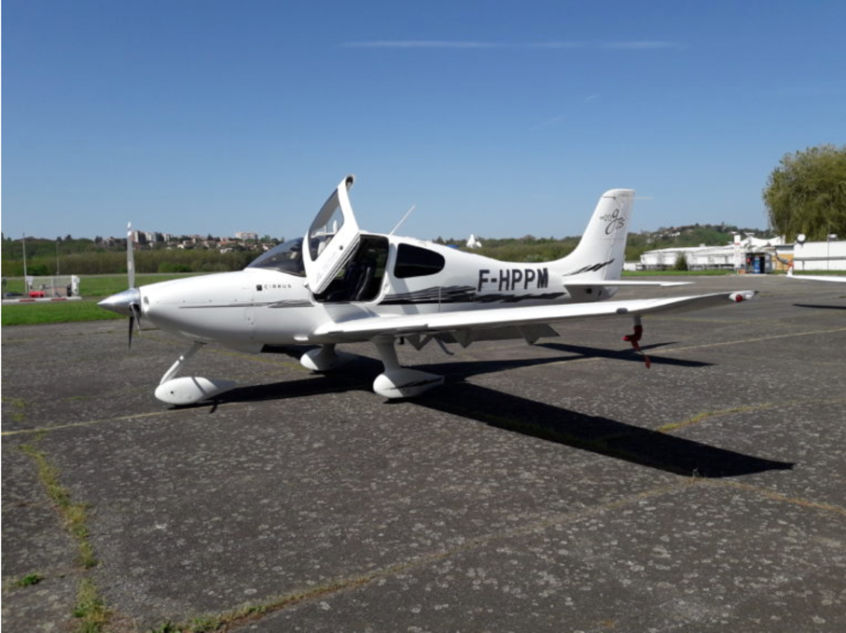
CIRRUS SR20/SR22 ELECTRICAL SYSTEM

Slide 12
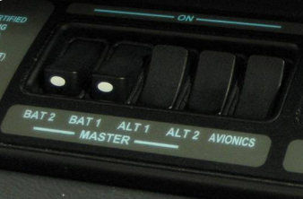
CIRRUS SR20/SR22 ELECTRICAL SYSTEM
ELECTRICAL SYSTEM CONTROLS
MASTER SWITCHES
Rocker type electrical system master switches are located in front
of the pilot on the bolster panel for easy access.
CIRCUIT BREAKER PANEL
Located on left side of center console
Alternating gray collars on the CB panel provides easier recognition
of circuit breakers
Circuit breakers are re-settable (once) !

Slide 13
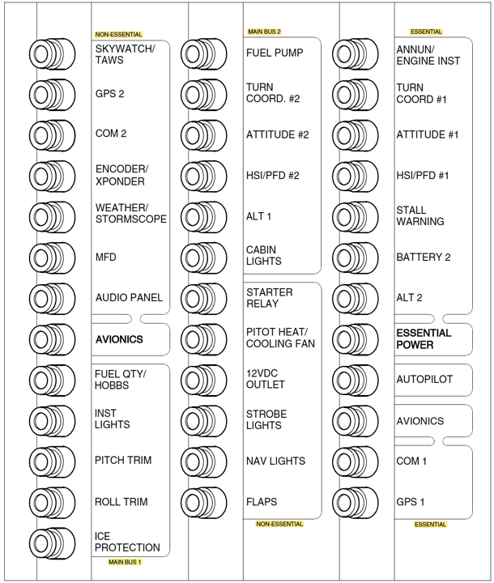
CIRRUS SR20/SR22 ELECTRICAL SYSTEM
ELECTRICAL SYSTEM CONTROLS
CIRCUIT BREAKER PANEL

Slide 14
CIRRUS SR20/SR22 ELECTRICAL SYSTEM

Slide 15
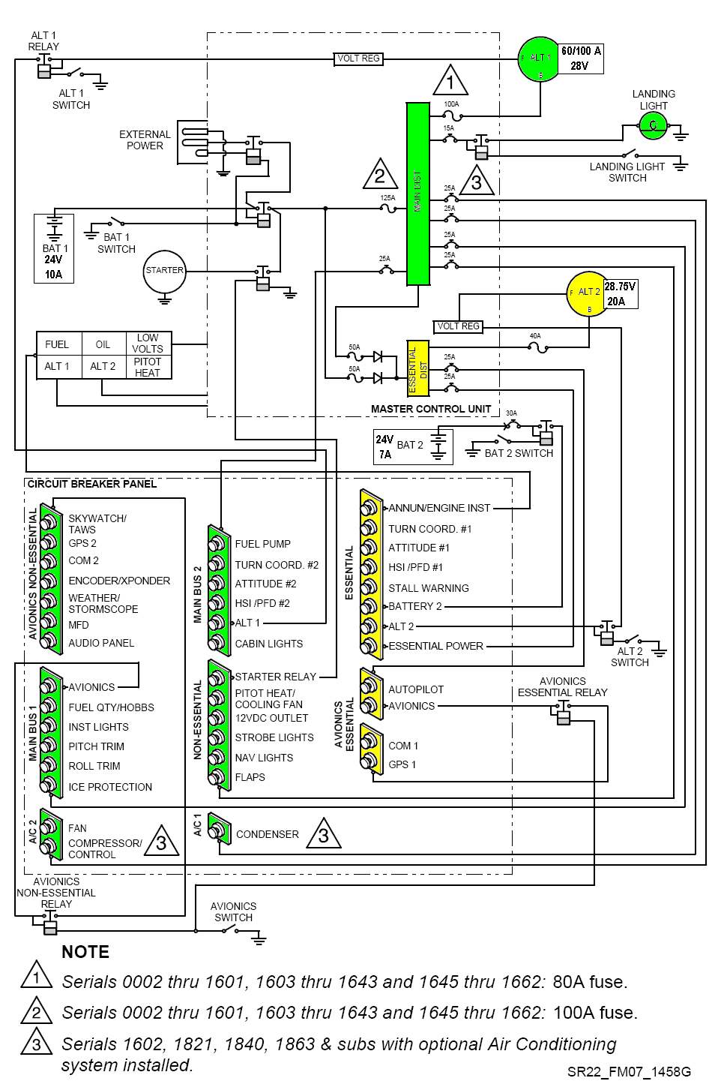
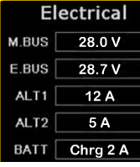
CIRRUS SR20/SR22 ELECTRICAL SYSTEM
NORMAL OPERATION
ALT 1_ 28 volts
Supplies power to Main Dist Bus
Charges BAT 1
Powers Essential Bus when aircraft is < 1700 rpm

Slide 16
CIRRUS SR20/SR22 ELECTRICAL SYSTEM
NORMAL OPERATION
ALT 2_ 28,75 volts
Supplies power to the Ess Bus during cruise flight
(>1700 rpm) because it operates at a higher voltage
Water analogy- Think of higher voltage as higher
pressure (water) running through the wires (pipes).
The higher voltage (pressure) of ALT 2 prevents ALT 1
from powering the Ess Bus
Charges BAT 2
Diodes prevent ALT 2 from powering the Main Dist Bus
Click on diagram to see “normal” engine indications

Slide 17
CIRRUS SR20/SR22 ELECTRICAL SYSTEM

Slide 18
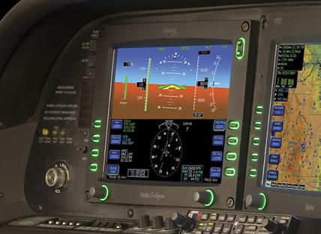
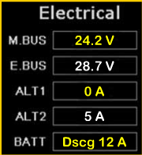
CIRRUS SR20/SR22 ELECTRICAL SYSTEM
ABNORMAL OPERATION
INDICATION OF AN ALT 1 FAILURE
Steady “ALT 1” caution light on annunciator panel
Main Bus (M.BUS) indicates a decreased voltage
Battery 1 (BATT) indicates a discharge
Verify on MFD engine page or ampere meter switch
ALT 1 (A)- 0
ALT 2 (A) – Normal
BATT 1 (A) discharging -12
How long will it last?
How to reduce drain on BATT 1?
Ess (V)- 28.7 ALT 2
Main (V)- 24.2 Bat1
ALT 1

Slide 19
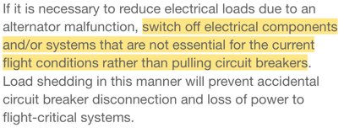
CIRRUS SR20/SR22 ELECTRICAL SYSTEM
ABNORMAL OPERATION
ABNORMAL PROCEDURE ALT 1 LIGHT STEADY
Analysis
Procedure
ALT 1 Master Switch – OFF
Alternator 1 Circuit Breaker – CHECK and RESET
ALT 1 Master Switch – ON
Switch off unnecessary equipment on Main Bus 1, Main Bus 2, and the
Non – Essential Buses to reduce loads. Monitor voltage
ALT 1 Master Switch – OFF
Land as soon as practical (continue flight, avoiding IMC or night conditions)
ALT 1

Slide 20
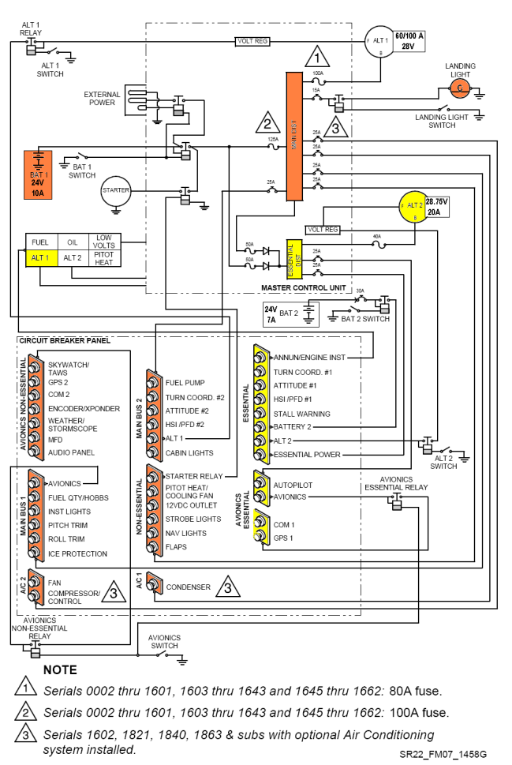
CIRRUS SR20/SR22 ELECTRICAL SYSTEM
ABNORMAL OPERATION
DISCUSSION ALT 1 FAILURE
BAT 1 powers Main Bus items
Turn off these items to reduce discharge
of BATT 1 if ALT 1 fails
Some items on the main bus have a primary
circuit breaker on the Ess bus (#1). These
items will be powered by ALT2 through
the Ess Bus (higher voltage)
Turn coordinator (hidden behind right
bolster panel to provide roll information
to the autopilot)
Attitude indicator
HSI/PFD
ALT 2 continues to power Ess Bus items
Complete ALT 1 failure checklist to attempt reset of ALT 1

Slide 21
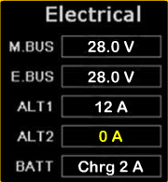
CIRRUS SR20/SR22 ELECTRICAL SYSTEM
ABNORMAL OPERATION
ALT 2 FAILURE
Steady “ALT 2” annunciator panel
Verify on MFD engine page or ampere meter switch
ALT 1 (A)- 12 Normal
ALT 2 (A) – 0
BATT 1 (A) Normal
Ess (V)- 28- Alt1
Main (V)-28- Alt1
ALT 2
ALT 1

Slide 22
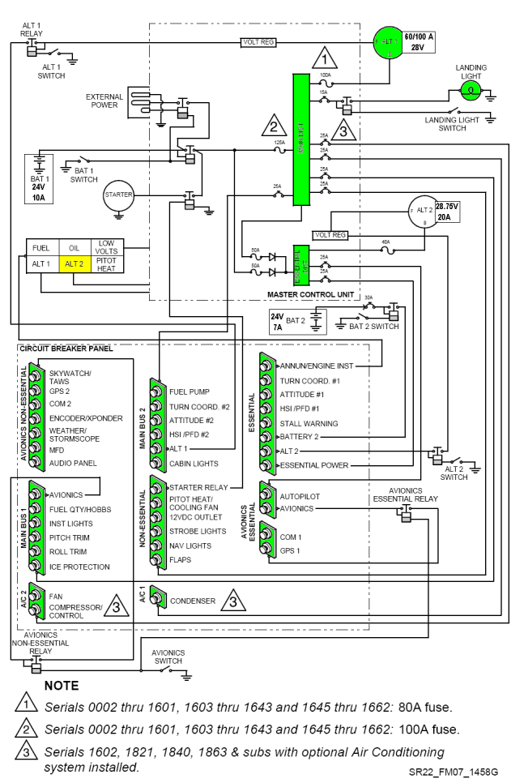
CIRRUS SR20/SR22 ELECTRICAL SYSTEM
ABNORMAL OPERATION
ALT 2 FAILURE
< 1700 RPMS ALT 2 will not work
ALT 1 will power the entire electrical system
Follow ALT 2 failure checklist and try to reset ALT 2
ALT 2 is required for IFR flight

Slide 23
CIRRUS SR20/SR22 ELECTRICAL SYSTEM

Slide 24
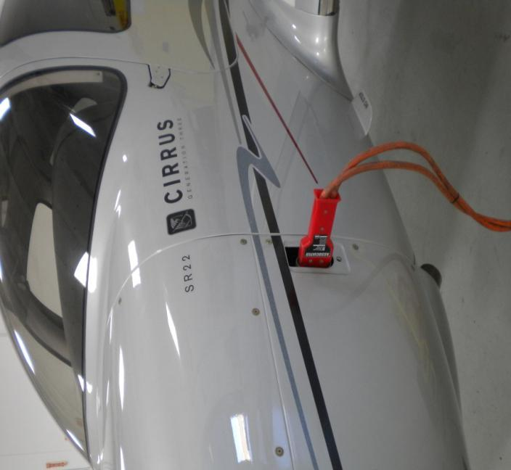
CIRRUS SR20/SR22 ELECTRICAL SYSTEM
GROUND OPERATION
GROUND SERVICE RECEPTACLE
Allows connection of an External Power Unit for
cold weather starting and maintenance
BAT 1 switch must be on to deliver power to system
BAT 1 must have power for the contactor to close
Recharging of BAT 1 should not be accomplished
through use of an External Power Unit
External Power Unit voltage must be regulated
to no higher than 28 VDC

Slide 25
CIRRUS SR20/SR22 ELECTRICAL SYSTEM
QUESTIONS
PREFLIGHT CHECK LIST
During the preflight check, why do we initially turn BAT 2 on only ?
Allows the pilot to check voltage (health) of BAT 2
To verify the isolation diodes are operating correctly- flap light out

Slide 26
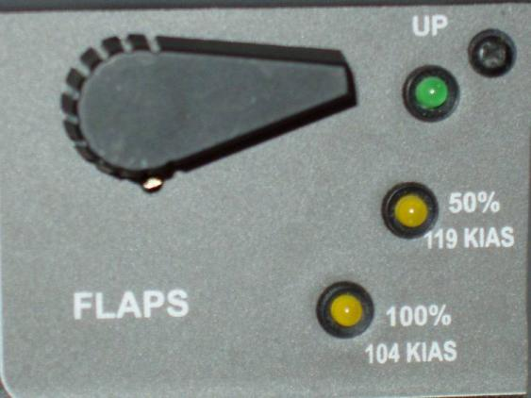
CIRRUS SR20/SR22 ELECTRICAL SYSTEM
QUESTIONS
PREFLIGHT CHECK LIST SCENARIO
During the preflight check with only BAT 2 on, you noticed the flap light was on.
Would you still depart for your flight?
Why or why not?
Go or No Go ?
The isolation diodes are not working correctly.
ALT 2 would then try to power the entire electrical
system. ALT 2 is 20 amps and not powerful enough
to power Main Distribution Bus items. This most
likely, will cause ALT 2 to fail.
The pilot would be unable to isolate items on the
Essential Distribution Bus in an emergency.
BAT 2 would try to the power Main Distribution Bus.

Slide 27
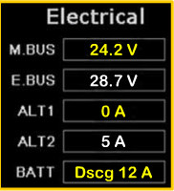
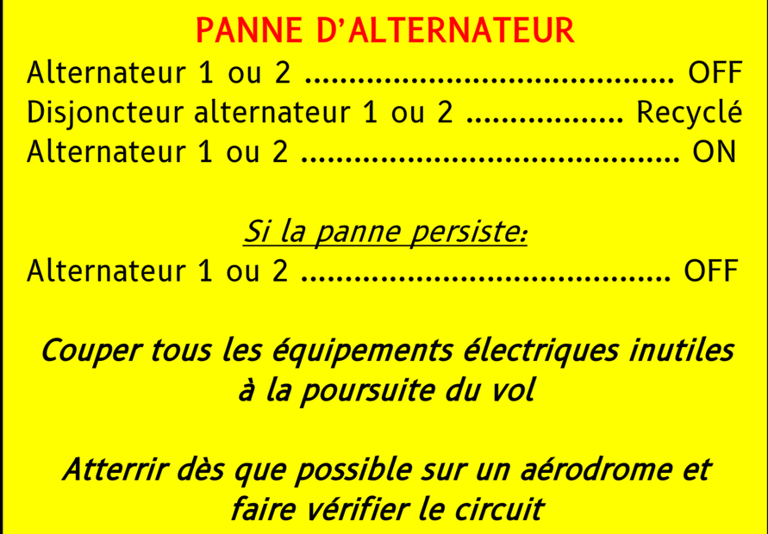
CIRRUS SR20/SR22 ELECTRICAL SYSTEM
QUESTIONS
FLIGHT SCENARIO
Looking at your engine data in cruise, this is what you see.
Has anything failed?
What are you going to do?
ALT 1 has failed. Perform ALT 1 failure checklist.

Slide 28
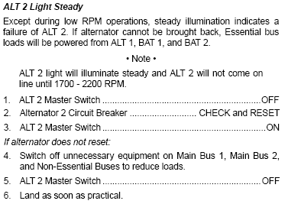
CIRRUS SR20/SR22 ELECTRICAL SYSTEM
QUESTIONS
FLIGHT SCENARIO
Looking at your engine data in cruise, this is what you see.
Has anything failed ?
What are you going to do ?
ALT 2 has failed. Perform ALT 2 failure checklist.

Slide 29
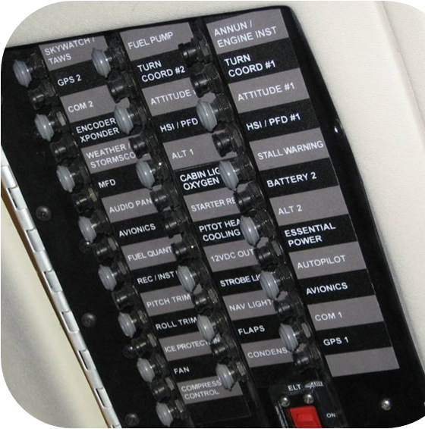
CIRRUS SR20/SR22 ELECTRICAL SYSTEM
QUESTIONS
FLIGHT SCENARIO
You are 30 minutes out from your destination
and you begin to smell something. After
investigating you see white smoke rising
from the circuit breaker panel.
What is happening ?
What will you do ?
Will your procedure be different in VMC vs. IMC ?
Day vs. Night ?

Slide 30
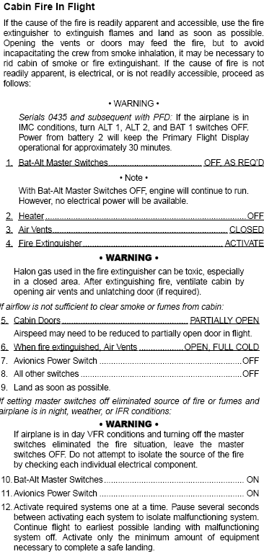
CIRRUS SR20/SR22 ELECTRICAL SYSTEM
QUESTIONS
FLIGHT SCENARIO
You are 30 minutes out from your destination
and you begin to smell something. After
investigating you see white smoke rising
from the circuit breaker panel.
What is happening ?
What will you do ?
Will your procedure be different in VMC vs. IMC ?
Day vs. Night ?

Slide 31
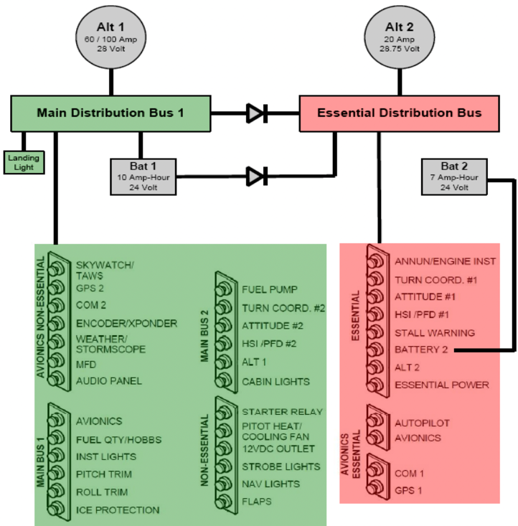
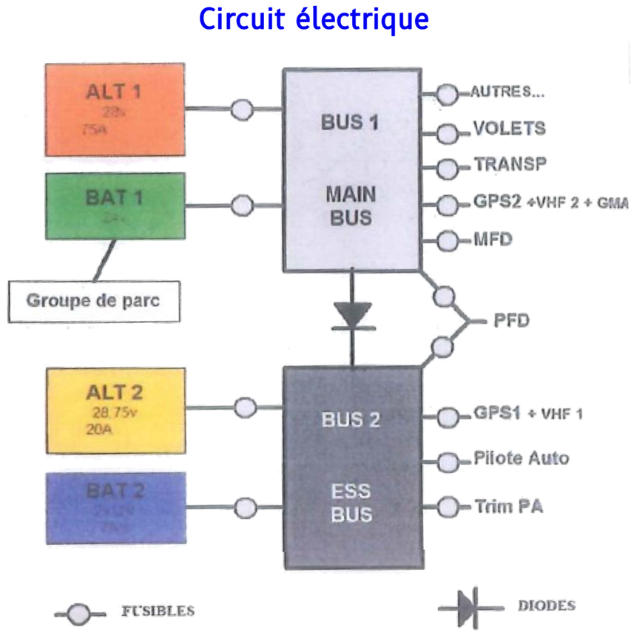
CIRRUS SR20/SR22 ELECTRICAL SYSTEM
RESOURCES
SIMPLIFIED ELECTRICAL DIAGRAM

Slide 32
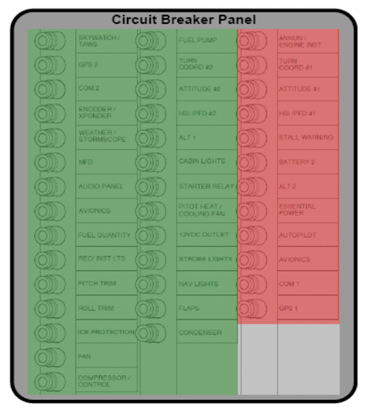
CIRRUS SR20/SR22 ELECTRICAL SYSTEM
RESOURCES
SIMPLIFIED ELECTRICAL DIAGRAM

Slide 33
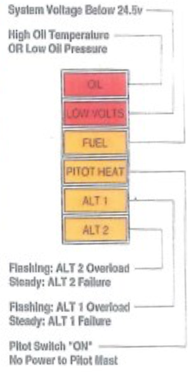
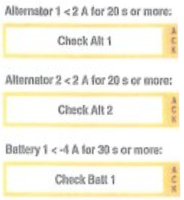
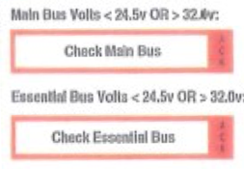
CIRRUS SR20/SR22 ELECTRICAL SYSTEM
RESOURCES
FAILURE MESSAGES

Slide 34
CIRRUS SR20/SR22 ELECTRICAL SYSTEM
QUESTIONS ?

